Slide 1

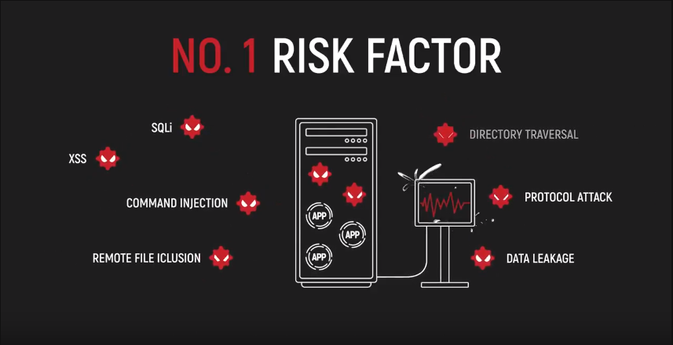

A TAILOR-MADE WAF
FOR LINUX WEB SERVERS
A FIREWALL WITH 8 EXTRA
DEFENSE MODULES IN
ONE SERVER SECURITY SUITE
Learn more
TRY IT NOW FOR FREE
No credit card required

Slide 2
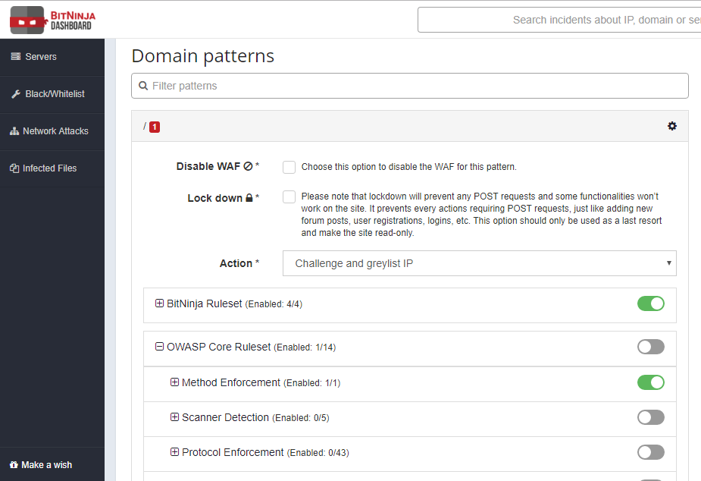
ALL WAF FEATURES YOU NEED IN ONE PLACE
OWASP Top10 coverage
Zero-day hotfixes
Virtual patching
Domain-based settings
Flexible deployment options (Log only/Active protection mode)
Emergency mode ( Lockdown feature)
Minimal latency
Automated rule updates
Guaranteed low false-positive rate
Bot protection
BitNinja SIEM for monitoring
Collective intelligence

Slide 3
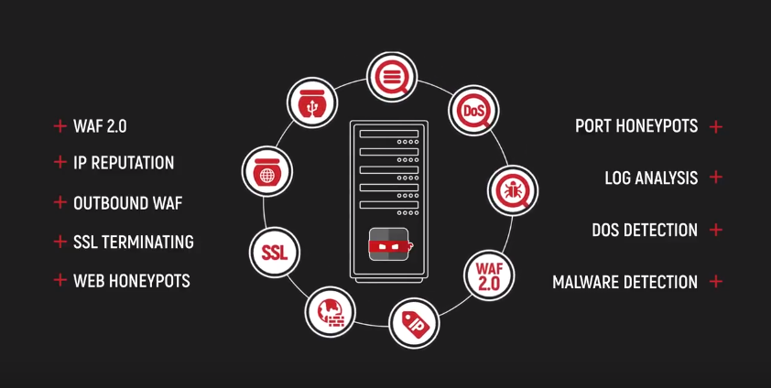
BitNinja combines 9 server security modules for full-stack protection

Slide 4
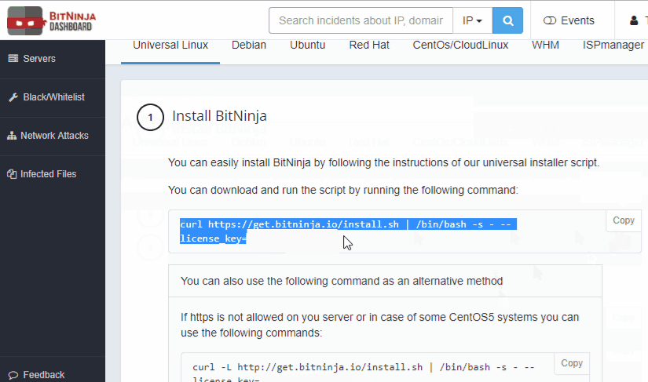

Setting up BitNinja is easy, takes just 5 mins
1. SSH to your server → 2. Run a one-line code → 3. Enjoy active protection!
And adjust settings on the BitNinja Dashboard (SIEM) as you wish

Slide 5



